Slide 1
The technology value stream Marlene Rodriguez Module 1.2

Slide 2
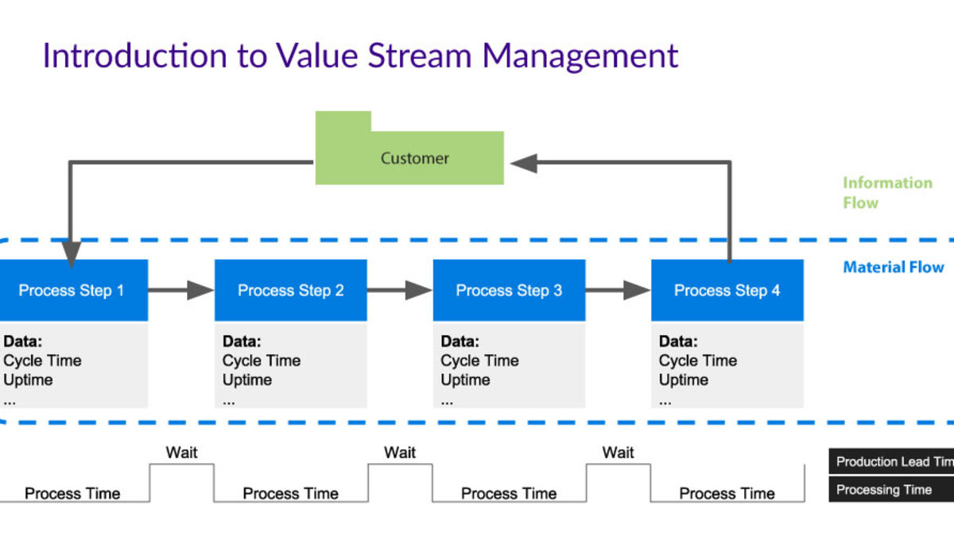
The technology value stream
The image pictures a process that is incorporated with the Technology Value Stream for leads time and processes.

Slide 3
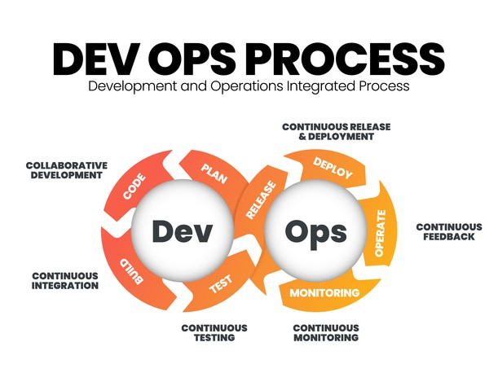
Devops process

Slide 4
Technology value stream
Benefits
Significant role in optimizing software development and delivery processes
Covers activities involved in delivering value to customers through products
Involves understanding and reducing lead times to accelerate delivery cycles
Enhances competitiveness and customer satisfaction

Slide 5
Lead time and processing time
Lead Time
Processing Time
Refers to total duration from when a request is made until the value is delivered to the customer
Encompasses all stages which include waiting, batching, and processing
Specific period spent actively working on the task itself
Reducing processing time does not shorten overall lead time
Attention must be paid to wait times and inefficiencies in the flow

Slide 6
Challenges faced
Deployment lead times can stretch for a few months longer
Lengthy cycles result from bottlenecks in phases which include lengthy approval processes, manual handoffs, and extended testing procedures
Delays can hinder companies from responding quickly to change which causes disadvantages
d

Slide 7
devops
Envisions reduced deployment lead times
Requiring continuous integration, automated testing, deployment that provides quick feedback
Organizations with these practices can implement the practices to shorten lead times and allowing faster delivery and liable releases
Accelerates delivery cycle and enhances quality by promoting ongoing automation and collaboration amongst teams

Slide 8
The Common scenario: deployment lead times requiring months
Common in large, complex organizations working with monolithic systems
Heroics are required for all stages of value stream when long deployment lead times are in play

Slide 9
Deployment lead times of minutes
Practice makes perfect
Developers receive fast constant feedback
Enables developers to quickly implement, integrate, and validate the code and have it deployed
Continuously checks small code changes into the version control repository, performs automated testing

Slide 10
References
The DevOps Handbook. Second Edition
What is Value Stream Management? | Atlassian
geeksforgeeks.org/devops/introduction-to-devops/

